Slide 1
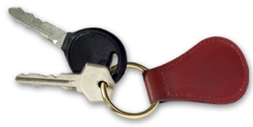

Module 2.2
Basic Control and Vehicle Balance
Montana Teen Driver Education and Training
Keys to Your Success
Notes:
Moving a car safely requires that the driver makes timely inputs to steering, braking, and acceleration. If these actions are done smoothly and timely then the car will stay in balance. If they are done quickly or randomly then the car will get out of balance and the ride will be uncomfortable at a minimum or cause a crash at the worst. The module is about keeping the car in balance and understanding what and how the driver does that.

Slide 2
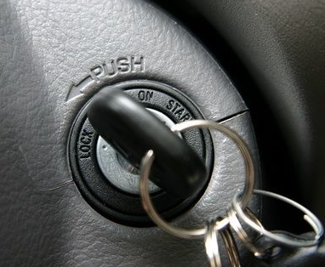
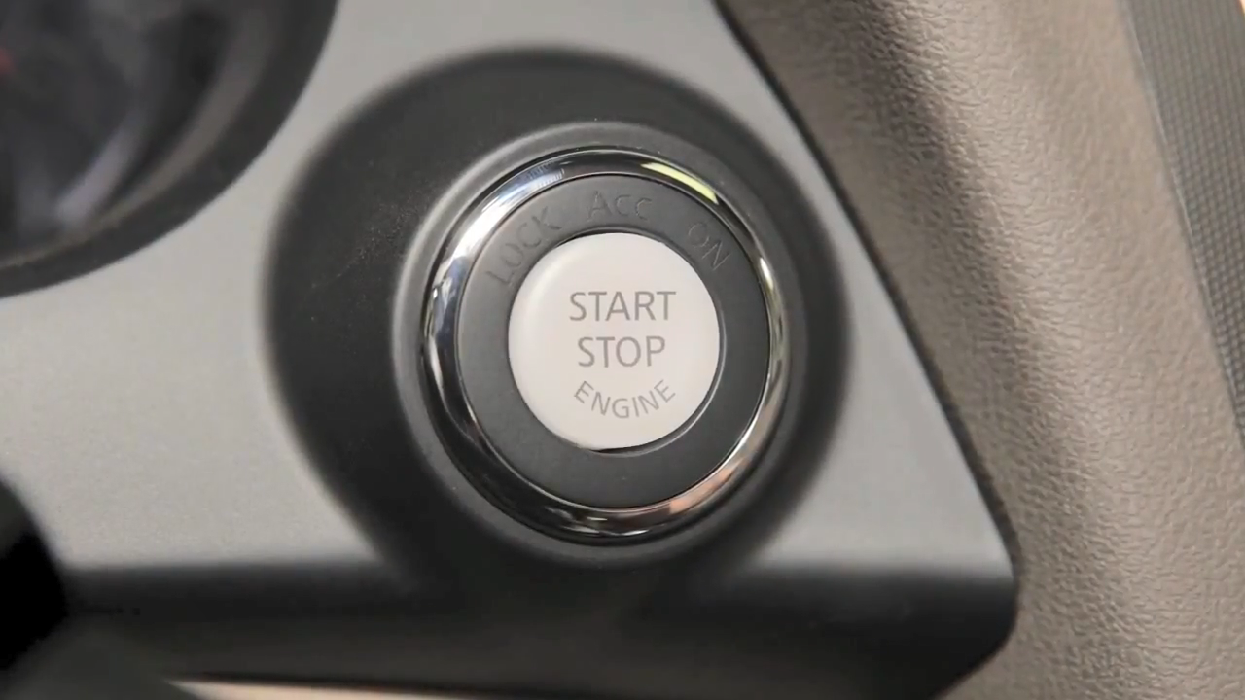
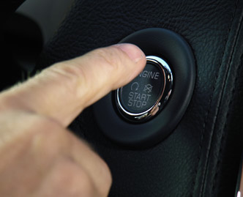
Starting the Vehicle
PUSH BUTTON IGNITION: VIDEO
Notes:
Starting the car has changed over the years.
The setup (we are assuming that the driver has already prepared to drive having gone over their checklist).
Foot on brake and clutch in for a standard transmission.
Vehicle in park or neutral for a standard transmission.
Twist the key, hold, then release when you hear the engine start.
Check gauges and to make sure the warning lights go out.
Adjust climate control, defroster, music player and radio before you shift into drive.

Slide 3
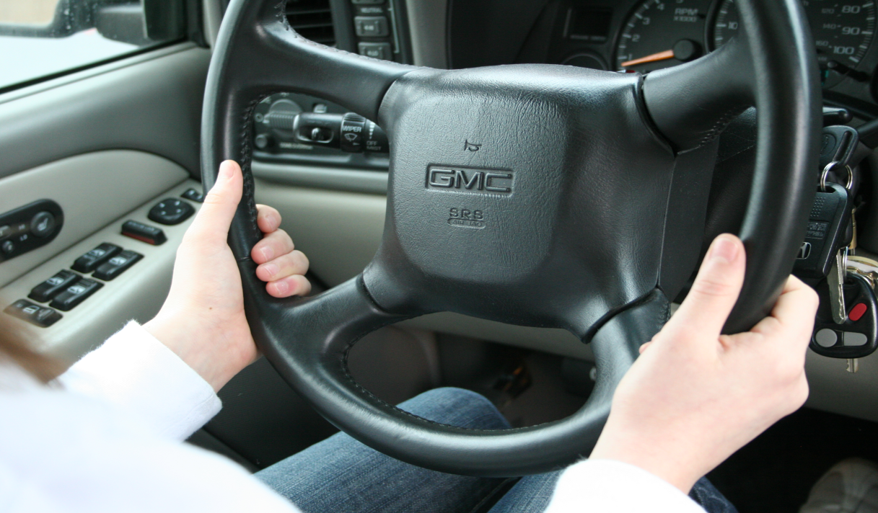
Steering
Holding the Wheel
Notes:
This picture identifies how to hold the wheel. Vehicle makers have designed the wheel so our hands can be comfortably placed on the wheel.
Imagine the face of a clock with the hands at 8 and 4 or 9 and 3.
Fingers wrapped around the wheel and thumbs on top of the wheel.

Slide 4
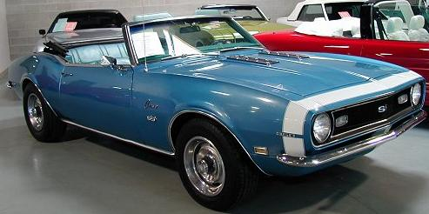
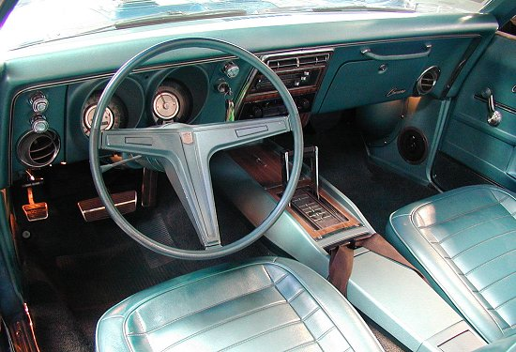
1968 Chevrolet Camaro SS
4-6 complete revolutions to turn the steering wheel
from locked to locked position
Notes:
The purpose of this slide is to show that the cars their parents and grandparents learned to drive on are different than today’s cars and therefore require different steering technique than the one being taught in driver education today. Plus, they are just really cool cars.

Slide 5
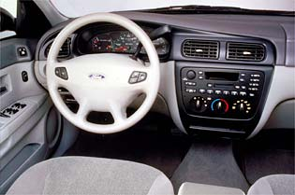
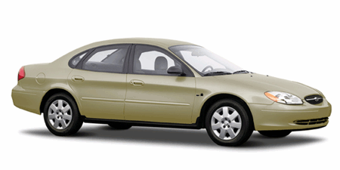
2001 Ford Taurus
Only 2 ½ revolutions to turn the steering wheel from locked left to locked right positions.
This changes the way we turn the steering wheel.

Slide 6
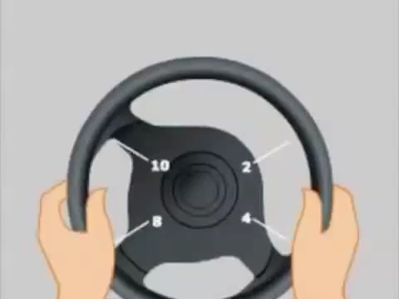
Steering
Hand TO Hand
Hand to hand demonstration: VIDEO
Notes:
Hand-over-hand steering
1. Use the top third of the steering wheel to move the wheel right or left
2. Repeat hand over hand steering to bring vehicle into the intended path
Hand over hand steering is useful for perpendicular parking at slow speeds and also when speed of steering is critical to control a skid.
Excessive steering input increases the risk of road departure crashes

Slide 7
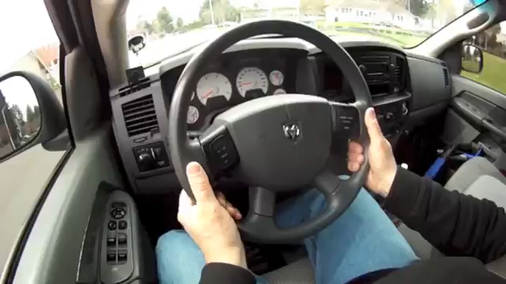
Steering
Push-Pull/Hand to Hand
VIDEO: Steering to the right.
Notes:
Hand-to-hand steering is useful for precision maneuvers, steering smoothly through curves, and intersection entry and exit.

Slide 8
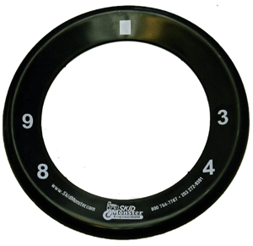
Steering Student Activity 2
Push Pull
Notes:
Practicing push pull steering.
Have students stand up with their wheels in their hands at 9 and 3 or 8 and 4.
Look to the target.
To turn the wheel push up to ten with the left hand while sliding the right hand to 2.
Pull down with the right hand to 4 while sliding the left hand back to 8.
Repeat the process until the wheel has turned about 3 times.
Now go the opposite direction.
Push the wheel up to 2 with the right hand and slide the left hand up to 10.
Pull the wheel down with the left hand to 8 while sliding the right hand down to 4.
Repeat the process until the wheel turns about 3 times.

Slide 9
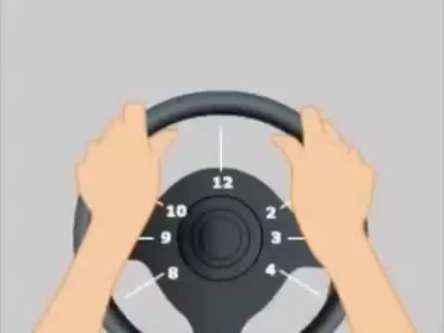
Steering
Hand OVER Hand
VIDEO
Notes:
Hand-over-hand steering
1. Use the top third of the steering wheel to move the wheel right or left
2. Repeat hand over hand steering to bring vehicle into the intended path
Hand over hand steering is useful for perpendicular parking at slow speeds and also when speed of steering is critical to control a skid.
Excessive steering input increases the risk of road departure crashes

Slide 10
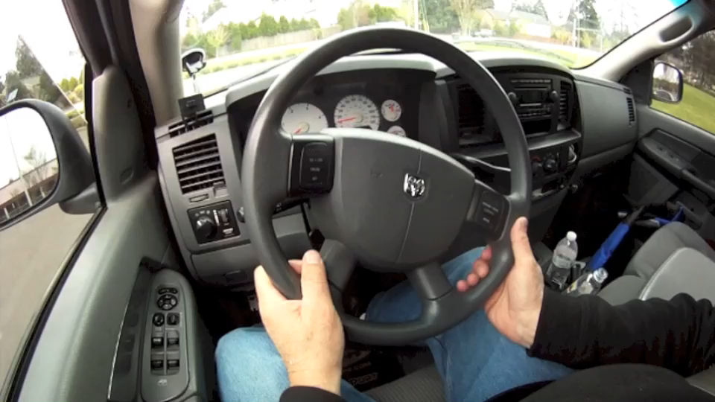
Steering
Push-Pull/Hand over Hand
VIDEO: Pulling over on left side and parking.
Notes:
Push-Pull steering for a right turn:
Push up with left hand while sliding your right hand up to 2 o’clock.
Pull down with your right hand.
Push-Pull steering for a left turn:
Push up with right hand while sliding your left hand up to 2 o’clock.
Pull down with your left hand
Hand-to-hand steering is useful for precision maneuvers, steering smoothly through curves, and intersection entry and exit.

Slide 11
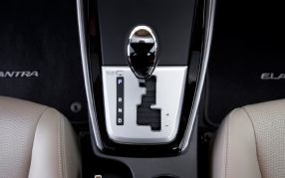
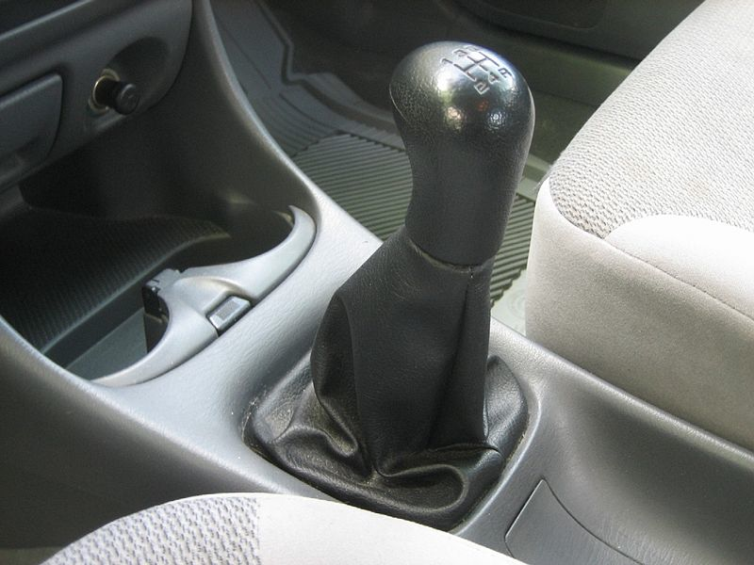
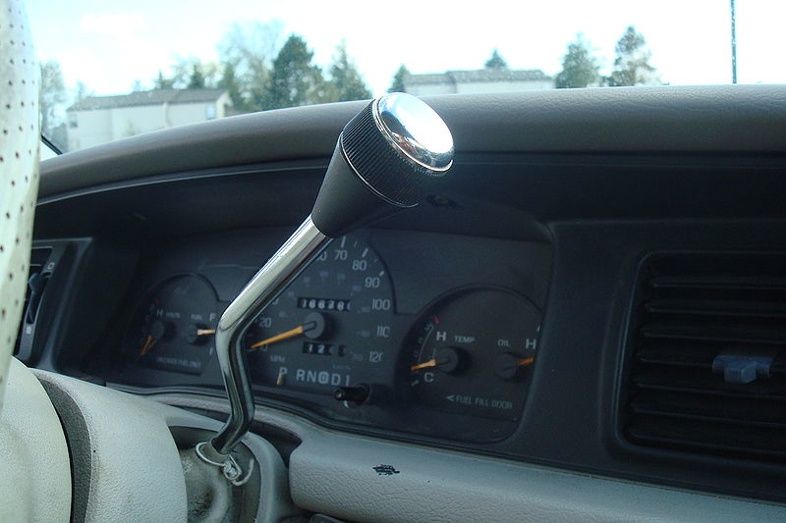
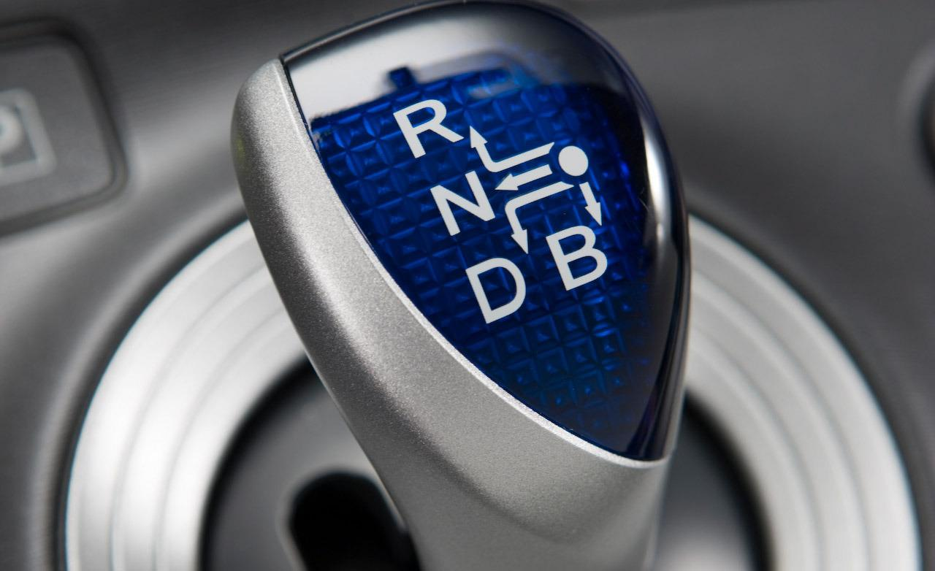
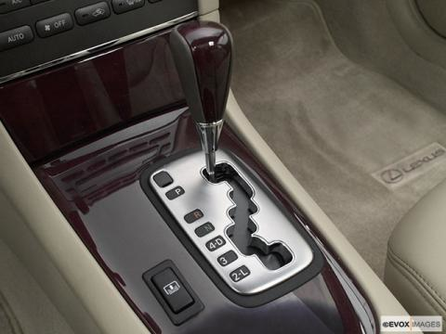
Shifting Into Gear
Notes:
Types of gear shift levers.
It is important to know about the different types of levers because cars are changing with each new model year.

Slide 12
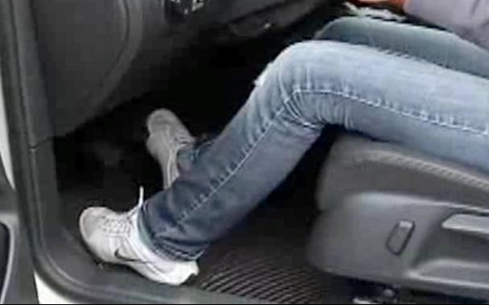
Accelerating
Notes:
Pivot foot from brake to accelerator while keeping the heel on the floor.

Slide 13
Accelerating
Cover (idle speed)
Light acceleration
Progressive acceleration
Thrusting acceleration
Notes:
Cover the accelerator—foot off the brake and over the accelerator. The idle speed is set to cause the car to move at about 3-5 miles per hour at idle speed.
Light Acceleration—slightly depressing the accelerator to increase speed. (students have a tendency to push too firmly thus causing the car to jerk ahead). This needs practice in the classroom.
Progressive acceleration—smoothly increasing the pressure on the pedal to progressively increase the car’s speed. Used to get into traffic or accelerate when a traffic light turns green.

Slide 14
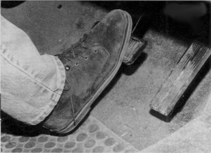
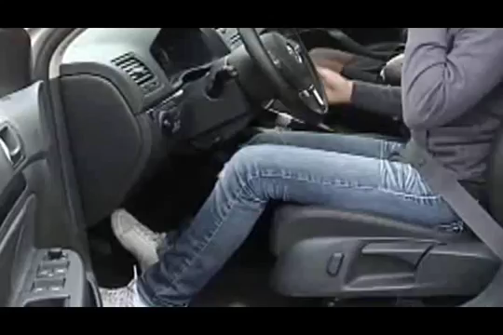
Braking
Notes:
Position the foot in front of the brake with the heel on the floor and the ball of the foot in contact with the brake pedal.
To move to the accelerator pivot the foot from the brake to the gas with the heel still on the floor.

Slide 15
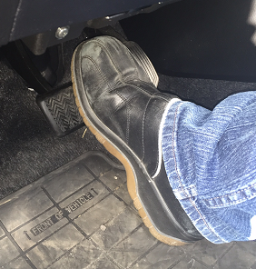
Braking
Cover
Controlled
Trail
Threshold
ABS
Notes:
Cover—move the foot from the accelerator and place it over and just above the pedal.
Controlled—Depress the brake pedal with heel still on the floor and pushing down the pedal with the ball of the foot. Car should slow.
Trail—In between controlled braking and cover the brake, it is the braking used while going downhill, the last seconds before a stop, and going through a curve that requires the driver to depress the brake pedal slightly.
Threshold—depressing the brake pedal firmly to the point of just before the brakes and wheels lock up and cause a skid.
ABS—Depressing the brake until the ABS pump engages and keeps the wheels from skidding thus maintaining rolling traction.

Slide 16
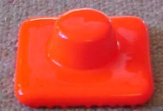
Braking Student Activity 3
Brake
Accelerator
Notes:
Proper seating
Hands on steering wheel
Foot properly positioned over pedal
Pivot the foot back and forth the brake pedal and gas pedal
Keep heel on floor and pivot the foot
Apply braking pressure for covering the brake
Apply braking pressure for controlled braking
Apply braking pressure for trail braking
Apply braking pressure for threshold braking
Apply braking pressure for ABS braking
Materials needed: Steering wheel, Simulated brake pedal, simulated accelerator

Slide 17

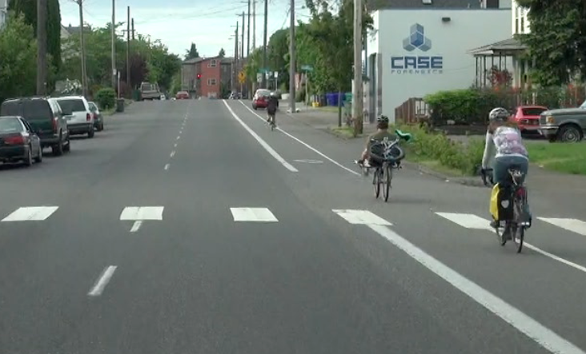
A Target is…
. . . a fixed object in the center of the path you intend to drive.

Slide 18
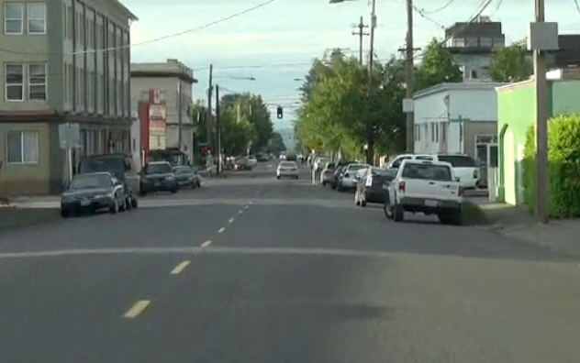
The Target Area. . .
. . . is the space to the left and right of your target.

Slide 19
The Targeting Path. . .
. . . is the path the car will travel. It is the space you will be driving into to reach your target.
Target
Targeting
Path

Slide 20
Three concepts for developing effective seeing habits are:
Target
Target Area
Targeting Path

Slide 21
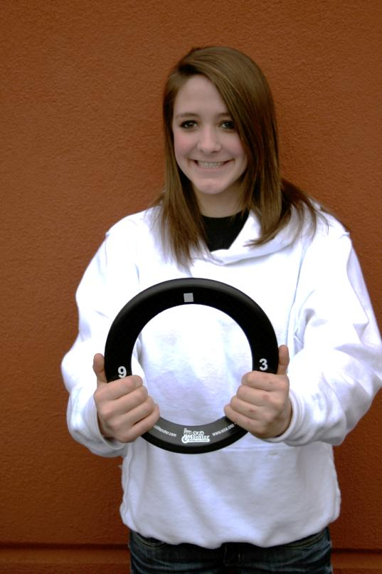
Student Activity 1
Notes:
Activity One
Have students obtain a steering wheel ring or paper plate works just as well.
Stand up facing the front of the class room
Look to a target you determine
Hold the wheel with the chin above the wheel and away from their chest about 1-1.5 feet.
Ask them if when they look to the target if they can still see the steering wheel without looking directly at it.
Keep the wheel handy because we are going to use it in a couple of minutes.

Slide 22
Vehicle Balance
Best balance when vehicle is not moving
Movement creates changes to vehicle balance
Vehicle balance can be mismanaged
Notes:
We know that an object at rest is in balance with the weight of the vehicle distributed equally to all four tires.
Movement causes the vehicle to become out of balance and any change in steering, acceleration or braking will affect the vehicle balance.
The driver in most crashes has mismanaged vehicle balance by putting too in much braking, steering or acceleration thus exceeding the capacity of the vehicle and its tires to hold the road. Timely use of vision helps the driver determine what speed and steering choices will work to keep the car in balance and thus on the road.

Slide 23
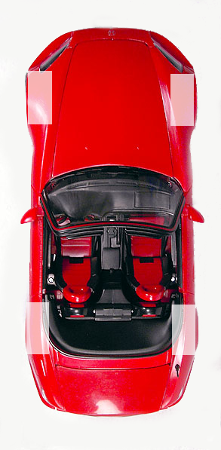
Best balance is when the vehicle is not moving.
Notice that its weight is evenly distributed on four tires.
Notes:
As we said before best balance is when the vehicle is not moving. The cut away tire patches shows that the tire foot print is exactly the same for each of the four tires.. This vehicle’s weight is evenly distributed on all four tires.

Slide 24
Vehicle Balance
Movement, starting, stopping, and turning creates change in vehicle balance.
Notes:
These are the four tire patches we saw from the previous slide. The car dynamics change as the driver brakes, accelerates, turns, and brakes and turns and the tire patches will change due to the weight transfer to different tires. Consider this, your life depends on those four patches doing their job of keeping the car in contact with the roadway. Changing vehicle balance will cause the tire patches to change size and affect their ability to hold the car on the road.

Slide 25
Vehicle Balance Technical Terms
Pitch
Roll
Yaw
Notes:
There are three terms we use when speaking of vehicle balance. Those terms are Pitch, Roll, and Yaw. When a car is sitting still these do not come into play. When the car is in motion however, they play an integral part in what the vehicle does on the roadway.

Slide 26
Student Activity 4-a
Everybody stand up
Pretend you are in a car moving at 55 mph
Show what happens to your body when
  the driver slams on the brakes.
  the driver makes a sharp right turn.
  the driver makes a sharp left turn.
Notes:
These activities are intended to have the student use what they already know about balance and motion.
The first activity is about pitch forward. The students should demonstrate a kind of bow at the waist.
The second activity should show roll to the left on a right turn.
The third activity should show roll to the right for a left hand turn.

Slide 27
Student Activity 4-b
Pretend you are in a car at a stop sign
Show what happens to your body when
  the driver stomps on the accelerator.
  the driver stomps on the accelerator and makes a sharp right turn.
Notes:
The students should lean backwards at the waist demonstrating pitch backwards.
The second activity should show the student lean backwards and their rear end should pivot around showing pitch and yaw

Slide 28
Student Activity 4-c
Pretend you are in a car at a stop sign on a snowy day
Show what happens to your body when
  the driver stomps on the accelerator and turns sharply to the right.
Notes:
On the last activity the student should spin around in circles because the car will swap ends in a yawing motion. This true more so with a rear wheel drive vehicle.

Slide 29
Vehicle Balance Technical Terms
Pitch – Vehicle weight is transferred to the rear tires when accelerating.
Notes:
The opposite is true for a hard acceleration. Thrusting acceleration will cause the weight to transfer to the rear making the tire patches larger in the rear and smaller in the front. If the acceleration is hard enough the tires can actually become small enough to drastically affect steering. You have probably seen drag racing where the wheels actually lift off the road. These are extreme cases but the effect is that the driver loses all steering capabilities.

Slide 30
Vehicle Balance Technical Terms
Roll - Vehicle weight is transferred to the side tires when turning or cornering.
Right Turn causes the energy to move to the side of the car
Notes:
With a hard right turn the weight is transferred to the outside left tires creating roll. The tire patch size increases on the left of the car because the weight of the car is transferred to the left as we redirect the energy of the car to the right. If the force exceeds the tires ability to hold the road it results in a skid. If the tires grip the road well and the speed is too great the car will literally roll over.

Slide 31
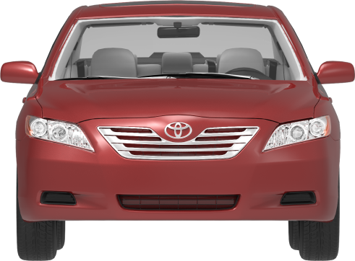
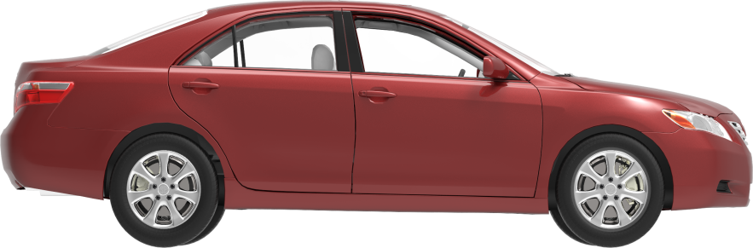
Vehicle Balance Technical Terms
Yaw – Traction to tires is lost causing vehicle to spin around its center of gravity or “Yaw” axis.
Notes:
If you could run a pole through the center of the passenger compartment from the floor to the roof this would be known as the yaw axis. A car can spin around this yaw axis if say during a curve both rear tires lose traction then the energy of the car would cause it to spin on the yaw axis. In the common vernacular it is known as a spin out.

Slide 32
What happens when you brake hard and steer to the right at the same time?
Notes:
What happens when you brake hard and steer to the right at the same time? You probably figured it out pretty quickly. The car pitches forward, The weight is transferred from the back to the front. The car also rolls because the weight is transferred to left wheels. Finally if the action is too great the car will yaw and the rear end will skid around in a yaw action.

Slide 33
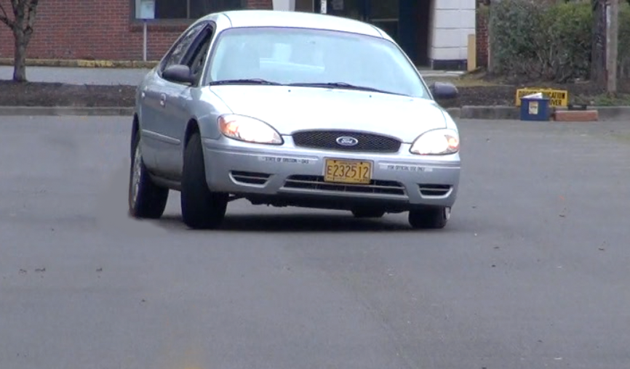
Notes:
Click through this slide and have the students describe what is happening with each tire in terms of weight transfer, traction and tire shape.

Slide 34
This diagram shows the tire pattern of the car in the previous slide.
Notes:
Notice that Left front tire. It has the most vehicle weight on it and thus has the largest tire patch. The right rear tire is the smallest tire patch. This has implications for traction for the car which could lead to a crash or spin out for the driver. This kind of hard braking and steering usually happens because the driver didn’t notice the low speed needed for a curve or tried to do an evasive steering and braking maneuver at the same time. Even so, the only way drivers can avoid making such maneuvers is to use the vision to manage vehicle dynamics.

Slide 35
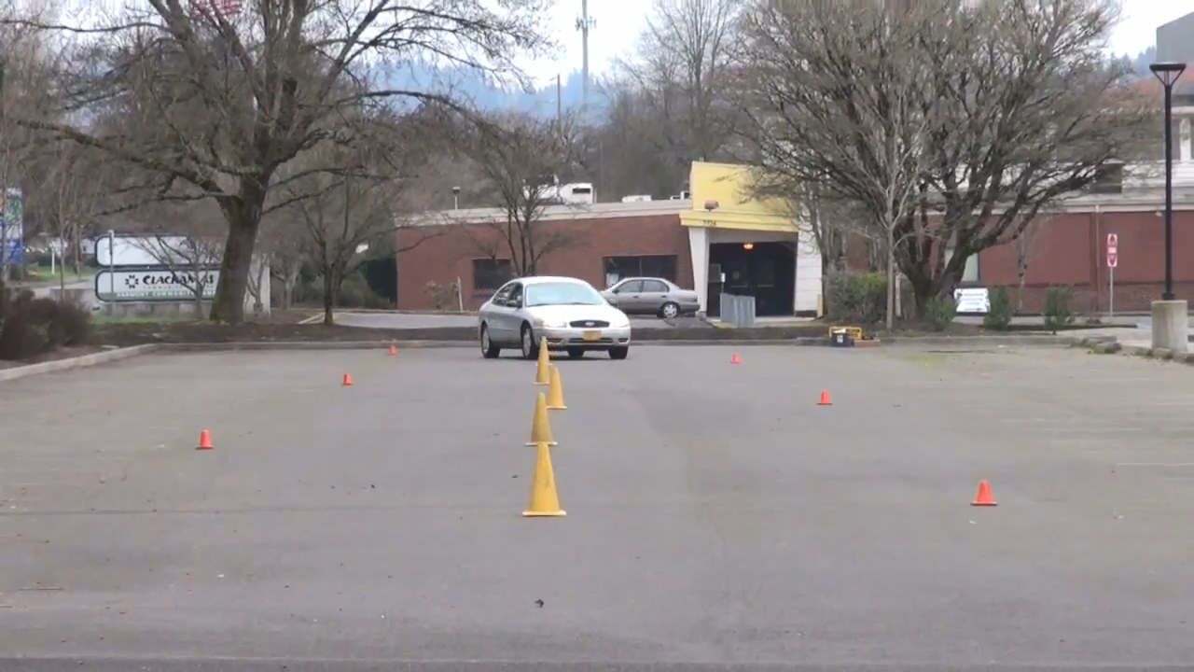
What happens to the vehicle balance as the driver gets closer to the end of the course?
What can the driver do to keep the car more in balance?

Slide 36
Montana Driver Education and Training
Standards and Benchmarks
1. Laws and Highway System
  1.1. know the laws outlined in the Montana Driver's manual;
  1.2. understand the laws outlined in the Montana Driver's Manual; and
  1.3. consistently demonstrate knowledge and understanding by responsible adherence to highway transportation system traffic laws and control devices.
2. Responsibility
  2.1. recognize the importance of making safe and responsible decisions for owning and operating a motor vehicle;
  2.2 demonstrate the ability to make appropriate decisions while operating a motor vehicle;
  2.3. consistently display respect for other users of the highway transportation system; and
  2.4. develop positive habits and attitudes for responsible driving.
3. Visual Skills
  3.1. know proper visual skills for operating a motor vehicle;
  3.2. communicate and explain proper visual skills for operating a motor vehicle;
  3.3. demonstrate the use of proper visual skills for operating a motor vehicle; and
  3.4. develop habits and attitudes with regard to proper visual skills.
4. Vehicle Control
  4.1. demonstrate smooth, safe and efficient operation of a motor vehicle; and
  4.2. develop positive habits and attitudes relative to safe, efficient and smooth vehicle operation.
5. Communication
  5.1. consistently communicate driving intentions (i.e., use of lights, vehicle position, and personal signals);
  5.2. adjust driver behavior based on observation of the highway transportation system and other roadway users;
  5.3. adjust communication (i.e., use of lights, vehicle position, and personal signals) based on observation of the highway transportation system and other users; and
  5.4. develop positive habits and attitudes for effective communication.
6. Risk Management
  6.1. understand driver risk-management principles;
  6.2. demonstrate driver risk-management strategies; and
  6.3. develop positive habits and attitudes for effective driver risk-management.
7. Lifelong Learning
  7.1. identify and use a range of learning strategies required to acquire or retain knowledge, positive driving habits, and driving skills for lifelong learning;
  7.2. establish learning goals that are based on an understanding of one’s own current and future learning needs; and
  7.3. demonstrate knowledge and ability to make informed decisions required for positive driving habits, effective performance, and adaptation to change.
8. Driving Experience
  8.1. acquire at least the minimum number of BTW hours over at least the minimum number of days, as required by law, with a Montana-approved driver education teacher; and
  8.2. acquire additional behind-the-wheel driving experience with a parent or guardian’s assistance in a variety of driving situations (i.e., night, adverse weather, gravel road, etc.).
Notes:
Standards and Benchmarks: This is for your reference and not to be read to the class verbatim. Please review prior to the lesson so you are aware of what the student will be required to know at the end of the module.

